Slide 1

Formula 1 history through data
February 2022

Slide 2
Participants
Sergio Gaytán
Jorge Ponce
Raciel Tavitas
Ricardo Barba

Slide 3

Formula 1 – Selected topic
The selection of the topic attended to the following reasons:
Long history from the sport,
available statistics from every race,
hard data available (i.e. racing times, number of laps, pit stops, final positions, etc.),
the data is verifiable,
complex and interesting questions to be solved.

Slide 4
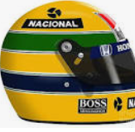
Question to be solved
The objective of the project is to display all the relevant data generated from this sport to obtain and understanding of the sport through data analysis for fans and new enthusiasts of the sport.
How relevant is the driver vs the car to determine a race output?
How relevant are the number of pit stops to a race output or winner?
Are mechanical failures significant to determine a race output or winner?
How relevant are the number of pole positions to determine a race output or winner?
Which factors are the determinant to get a F1 race winner?
Identify which other variables could be relevant to affect the result of a race.
.

Slide 5
Technologies and tools

Slide 6



Technologies
Amazon Web Services
Postgress
Tableau

Slide 7




Tools and languages
Github
Jupyter notebook
SQL
Python

Slide 8
Data source, exploration and processing

Slide 9
Database processing
Extract
- Identify data sources
-Verify accuracy
Data exploration and transformation
- Clean data
- Perform preliminary analysis
- Calculate relevant data
- Create data frames
Load
- Load data to Postgress
- Integrate data for processing

Slide 10
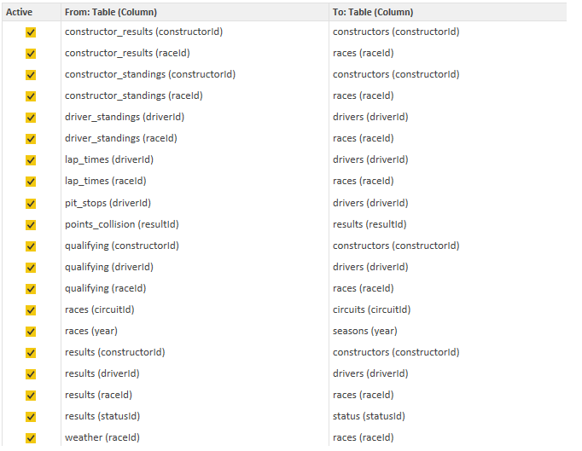
Database Source
A research was made for information that can be usable for these purposes, the characteristics of the data that could be used for the purposes of our project are the following:
Should be accurate.
Should be verifiable.
Should be diverse enough to perform our analysis.

Slide 11
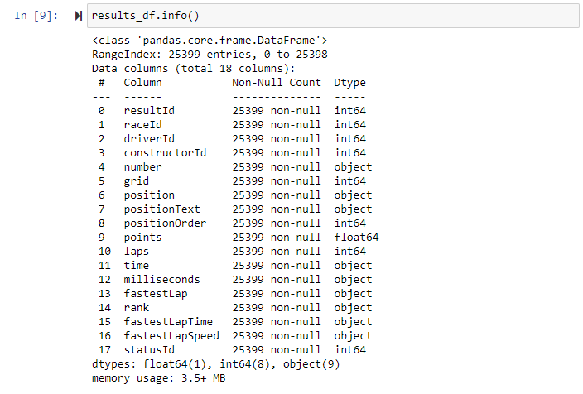
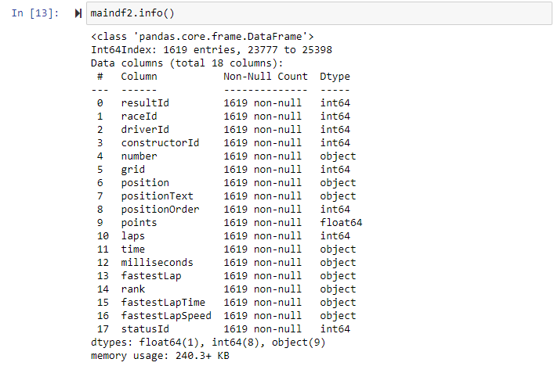
Database Exploration
Identify relevant databases.
Limit data from season 2018 to 2021 for comparation and processing purposes.
Perform preliminary data analysis with 1619 observations.

Slide 12
data exploration - Preliminary analysis
The variable that give an answer to the study question is the column called positionOrder.
The most successful teams in the study period are Mercedes, Red Bull and Ferrari, while those that obtain the most negative results are Williams, Haas and AlfaRomeo.

Slide 13
data exploration - Preliminary analysis
The drivers with the best results are Hamilton, Max Verstappen and Bottas. While the drivers with the worst ratings are Pietro Fittipaldi and Mazepin.

Slide 14
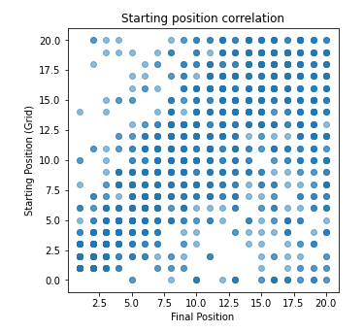
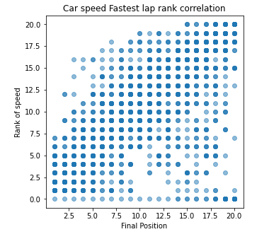
data exploration - Preliminary analysis
Starting position(grid)/Final position correlation
Car speed/Final position correlation.

Slide 15
Database integration process
CSV
AWS/S3
Google Colab
PG Admin SQL
AWS/RDS

Slide 16
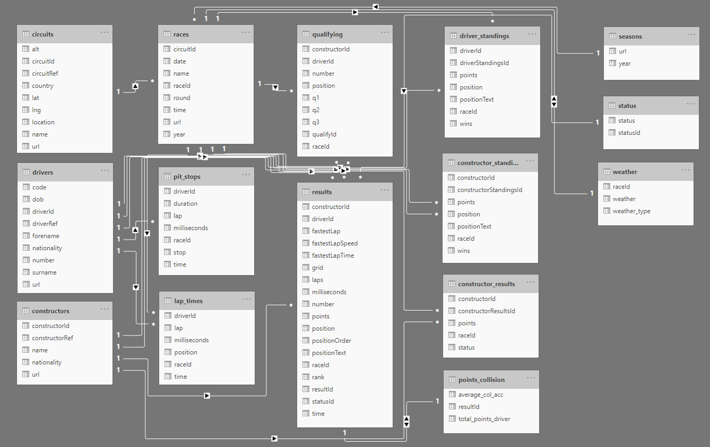
Database integration
This is the visual schema and the relationships all table have:

Slide 17
Description of the analysis phase of the project (Machine learning models)

Slide 18
Machine learning models
Supervised machine learning model type could deal with the research question, as the database have a column with the final position for every race.
Logistic regressions
Support Vector Machines
Random Forest Classifier
Gradient Boosting Classifier
Resume
To compare the performance of all the models, a comparative table was created, it is observed that logistic regression model is the one that presents the highest precision and the highest result in the F1 Score.

Slide 19
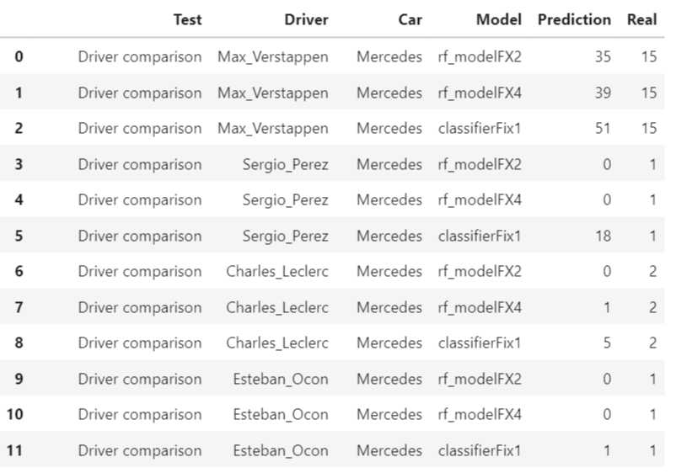
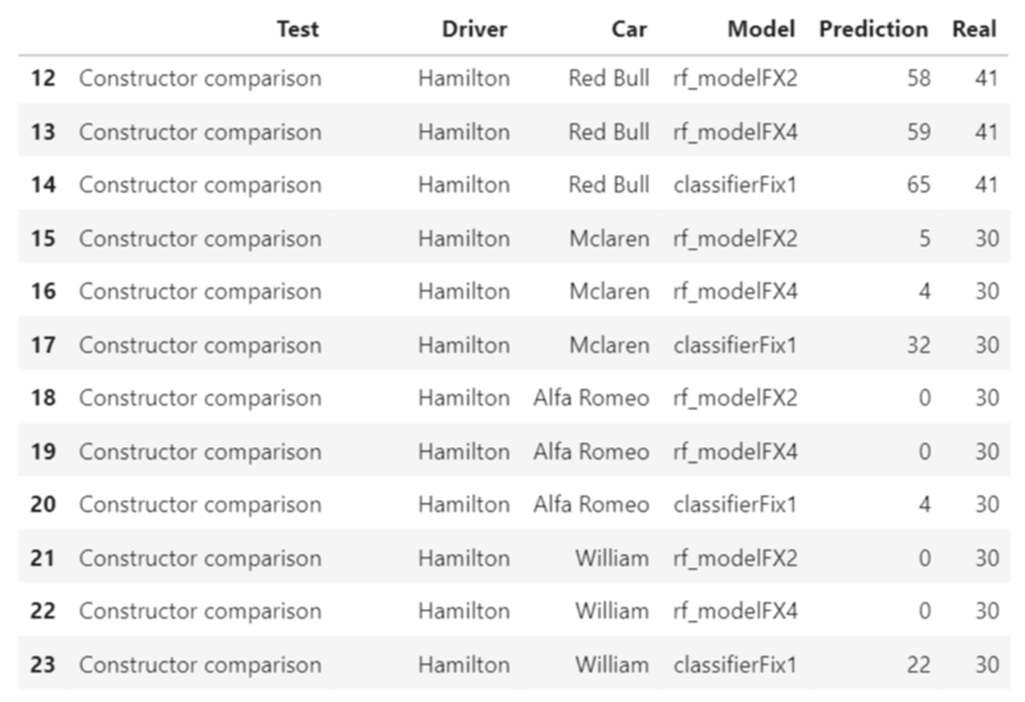
Machine learning models test results

Slide 20
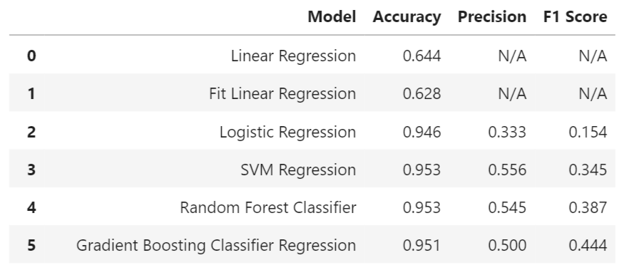
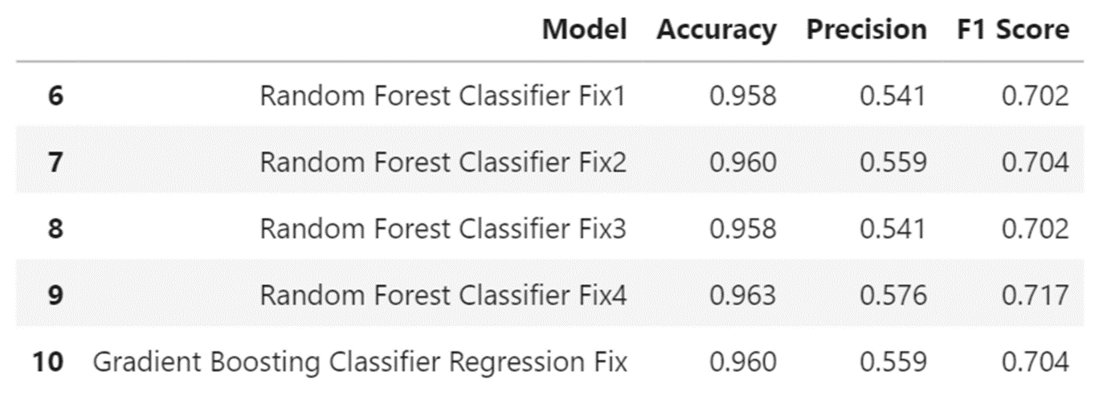
Machine learning models test results

Slide 21
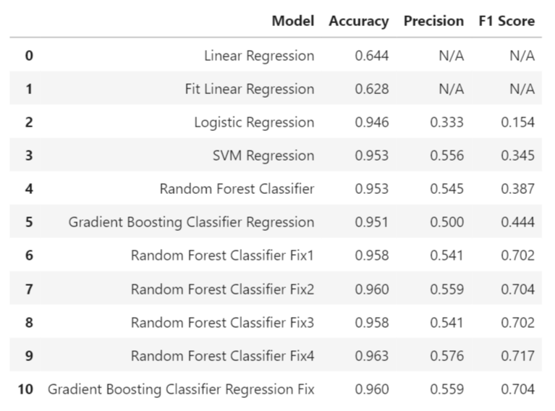
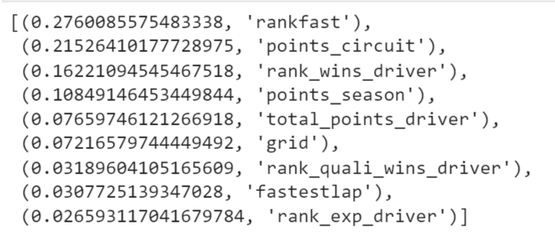
Machine learning models test results

Slide 22
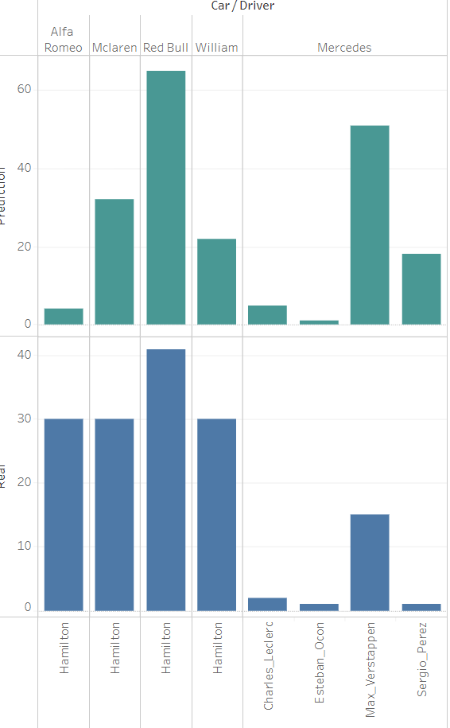
ClassifierFix 1

Slide 23
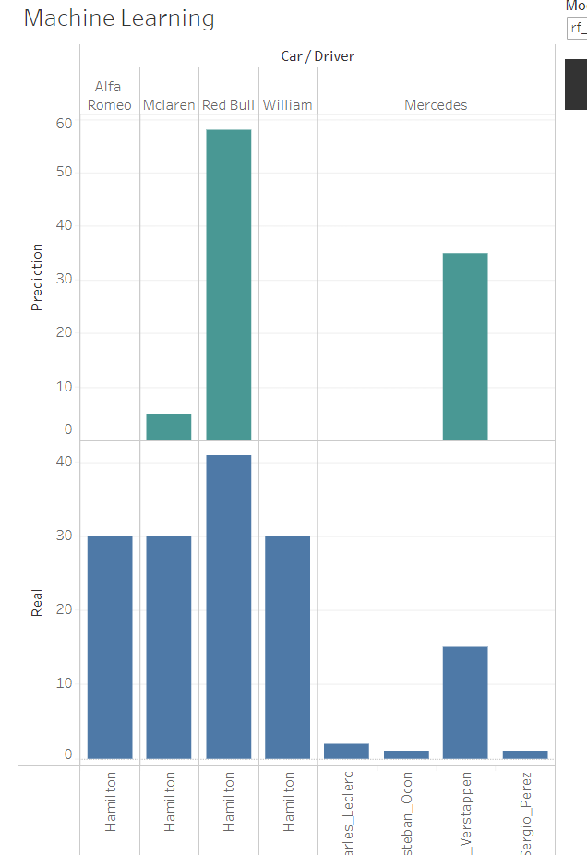
Rf1-modelFX2

Slide 24
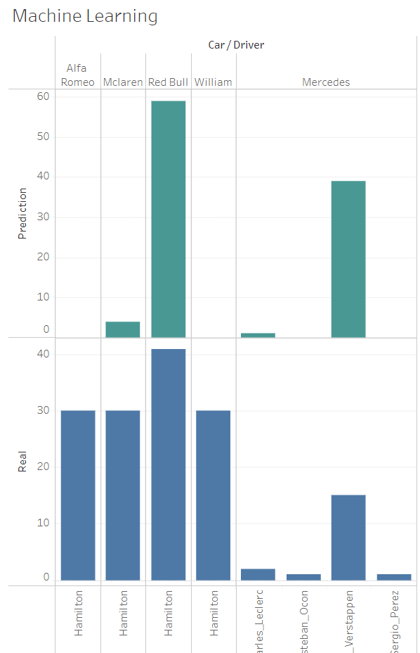
Rf_modelFX4

Slide 25
Visual presentation and dashboards

Slide 26

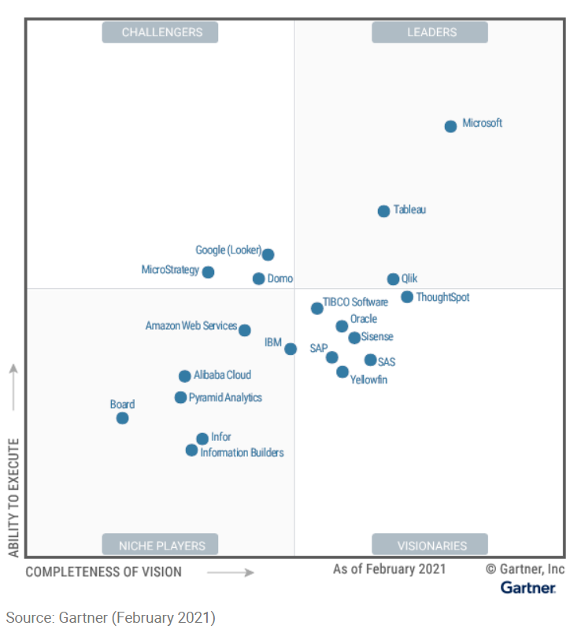
Tableau
Tableau is a visual analytics platform transforming the way we use data to solve problems—empowering people and organizations to make the most of their data
Tableau is acknowledged as one of the leaders in industry to cover BI&A (Business Intelligence and Analytics) just behind Power BI as per Gartner 2021 magic quadrants for BI&A

Slide 27
Interactive dashboard
https://public.tableau.com/app/profile/raciel3899/viz/FINALPROJECT8/F1PROJECT?publish=yes

